Slide 1

Introduction to Jenkins
Module 2: Jenkins Overview

Slide 2
Module Topics
Jenkins in modern DevOps ecosystems
Jenkins LTS architecture and components
Plugins, security model, and governance
Controller/agent overview
SCM-driven automation (GitHub, GitLab)
Installing Jenkins LTS
Running Jenkins in Docker
Configuration-as-Code (JCasC)
Initial setup wizard and global tools

Slide 3
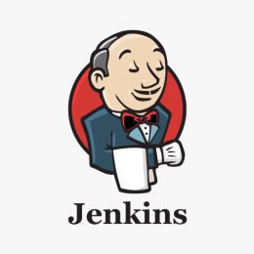
Origins
In the early 2000s, most software teams
  Integrated code infrequently
  Ran builds manually
  Discovered integration problems late in the development cycle
In 2004 by Kohsuke Kawaguchi at Sun Microsystems created the Hudson project
  Open-source written in Java
  Designed to automate builds and tests
  Integrated well with Java build tools like Ant and Maven
  Easy to set up and extensible
  Focused on automation rather than process enforcement

Slide 4
Hudson to Jenkins (2011)
In 2010–2011, Oracle acquired Sun Microsystems
  This led to disagreements between the Hudson community and Oracle regarding
    Project governance
    Trademark ownership
    Contribution control
As a result
  The community forked Hudson
  The new project was named Jenkins
  Most contributors and users moved to Jenkins
From this point on
  Jenkins became a community-driven project and the dominant tool for pipeline automation
  Hudson gradually declined in relevance

Slide 5
Job Centric CI (2011–2014)
Early versions of Jenkins focused on
  Freestyle jobs
  UI-driven configuration
  Scripted build steps
Characteristics of early Jenkins
  Configuration stored on the server
  Heavy reliance on plugins
  Tight coupling between built configurations and tool chains
  Builds were often non-reproducible, especially after configuration changes
This reflected the state of CI at the time
  Automation existed, but IaC was not common, nor was the idea of a pipeline

Slide 6
Pipeline as Code (2014–2016)
As DevOps practices matured, teams demanded
  Configuration of the pipeline logic needed to be versioned as the logic evolved
  Reproducibility became a primary concern: consistent builds
  Better support for complex workflows
This led to the introduction of the Jenkins Pipeline and Jenkinsfile
Innovations
  Pipelines defined in code
  Stored in Git repositories
  Reviewed like application code
  Support for stages, parallelism, and conditions
This marked a major evolution in Jenkins’ design philosophy

Slide 7
DevOps Era (2016–Present)
Jenkins evolved to support
  Microservices
  Containers and Docker
  Kubernetes-based build agents
  Cloud-native workflows
Notable Trends
  Declarative pipelines simplified syntax
  Dynamic agents replaced static build servers
  Integration with modern SCM platforms (GitHub, GitLab)
Jenkins shifted from being “a CI tool” to a general-purpose automation engine

Slide 8
Jenkins Today
Why Jenkins is still relevant
  Extreme flexibility
  Large plugin ecosystem
  Strong support for legacy and complex systems
Challenges
  Requires operational effort
  Plugin compatibility management – many plugins are maintained by volunteers
  Competition from managed CI/CD platforms like GitLab
Despite newer tools, Jenkins remains widely used in
  Large scale enterprises
  Regulated environments
  Complex, heterogeneous systems

Slide 9
GitLab and GitHub
GitHub Actions and GitLab CI/CD are modern alternatives to Jenkins pipelines
  These are integrated pipeline tools built directly into their Git hosting services
These repository tools treat CI/CD as a native feature of the repository
  Jenkins = external automation engine
  GitHub/GitLab = pipelines embedded in the SCM platform
The same basic pipeline concepts apply to these as to Jenkins
  The syntax and format of the configuration files differs
  GitLab/GitHub use yaml configuration files
  Jenkins uses groovy scripting

Slide 10
GitHub Actions
GitHub Actions
  GitHub’s built-in automation and CI/CD platform
  Pipelines are defined using YAML workflow files stored in the repository
Key characteristics
  Tight integration with GitHub repositories
  Event-driven (push, pull request, tag, issue events)
  Pipelines live in the directory “.github/workflows”
  Uses hosted runners or self-hosted runners
Conceptual flow
  GitHub event → Action workflow → Jobs → Steps
Strengths
  Zero infrastructure to manage
  Simple setup for GitHub users
  Strong marketplace of reusable actions

Slide 11
GitLab CI/CD
GitLab CI/CD is a first-class feature of GitLab, not an add-on.
  Pipelines are defined in a file: “.gitlab-ci.yml”
Key characteristics
  CI/CD tightly integrated with GitLab repos
  Built-in artifact storage and environment tracking
  Native support for Docker and Kubernetes
  GitLab runners execute jobs
Conceptual flow
  Git commit → GitLab pipeline → Stages → Jobs
Strengths
  Very cohesive developer experience
  Strong DevOps lifecycle integration
  Minimal configuration overhead

Slide 12
Comparison
Configuration style contrast
Jenkins
  Highly flexible
  Scriptable pipelines (Groovy)
  Powerful but verbose
  Requires plugin management
GitHub / GitLab
  Opinionated YAML syntax
  Simpler mental model
  Less customization, faster onboarding
  Platform constraints apply

Slide 13
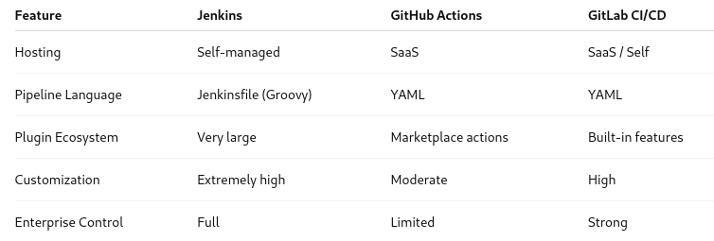
Jenkins vs GitHub Actions vs GitLab CI/CD

Slide 14
Jenkins vs GitHub Actions vs GitLab CI/CD
Jenkins is preferred for
  Complex, multi-tool workflows
  Hybrid or on-prem environments
  Advanced customization needs
  Regulated industries
  Long-running or specialized builds
GitHub/GitLab are preferred for
  Simple to moderate pipelines
  Tight integration with SCM
  Minimal infrastructure management
  Fast onboarding

Slide 15
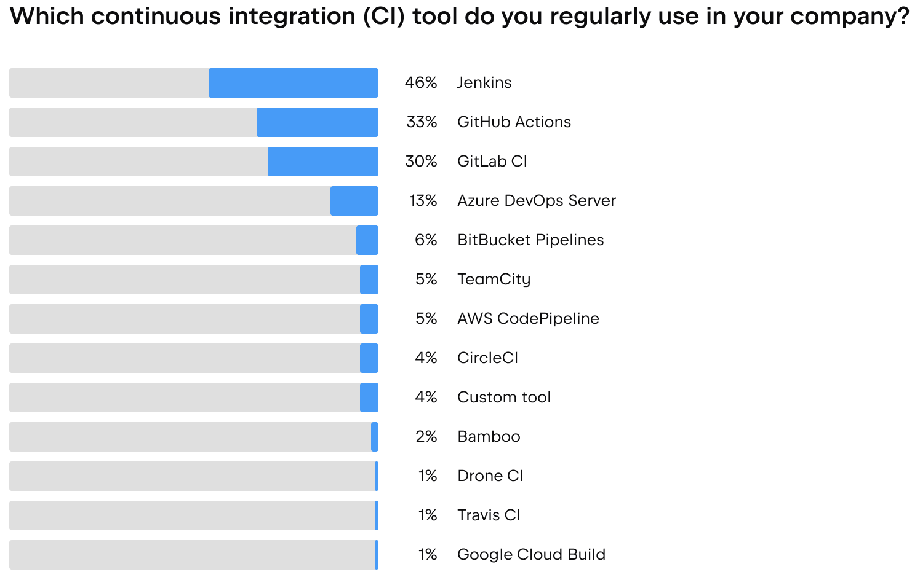
Comparison
Jenkins is often chosen when there is a need for
  Extreme customization
  Supporting many SCM systems
  Supporting complex legacy workflows
  Infrastructure is managed and controlled
GitHub / GitLab pipelines are often chosen when
  Repositories are already hosted on the platform
  Teams want fast setup
  Minimal operational overhead is desired
  Standard CI/CD patterns are sufficient
Image Credit: https://blog.jetbrains.com/teamcity/2023/08/how-to-choose-cicd-tool/

Slide 16
Modern DevOps Ecosystems
Jenkins is an automation engine that
  Listens to SCM events
  Executes pipelines
  Orchestrates execution of builds, tests, scans, and deployments
  Integrates with many external tools
    SCM: GitHub, GitLab, Bitbucket
    Build tools: Maven, Gradle, npm, pip
    Containers: Docker, Podman
    Kubernetes: Jenkins Kubernetes plugin
    Quality & Security: SonarQube, Snyk, Trivy
    Secrets: Vault, cloud KMS systems
Jenkins is usually the best choice when
  The pipeline needs to integrate across a variety of tool chains
  Full control over pipeline workflows is required
  Operational needs span hybrid or multi-cloud environments

Slide 17
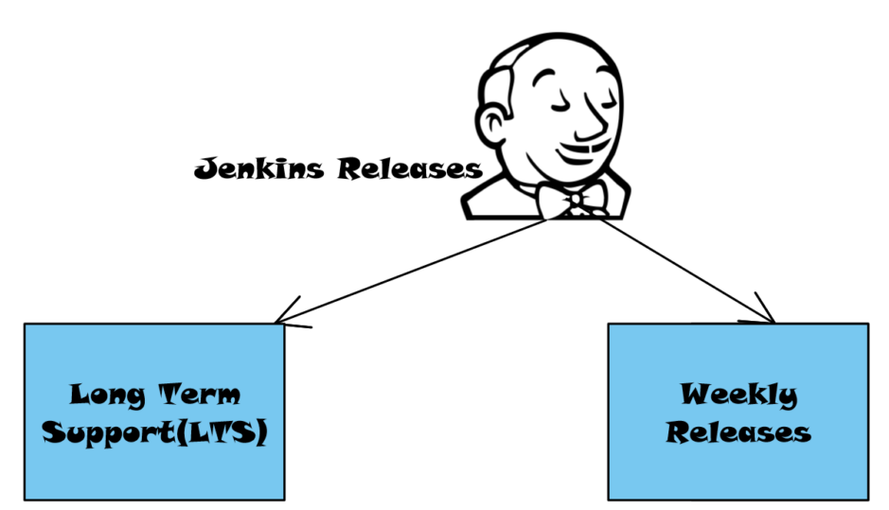
Jenkins Release Model
Jenkins has two release lines
Weekly releases
  New features
  Faster change
  Higher risk
LTS (Long-Term Support)
  Stability-first
  Security patches backported from the weekly releases
  Recommended for production
Image Credit: https://www.testingdocs.com/category/jenkins/

Slide 18
Jenkins Weekly Releases
Represent the latest state of Jenkins development
Typically used by
  Plugin developers
  Jenkins core contributors
  Early adopters testing new features
  Teams validating future LTS upgrades
Not meant for
  Production controllers
  Regulated environments

Slide 19
Jenkins LTS
Recommended for production environments
  Plugins are tested primarily against LTS
  Predictable upgrade cycles
    Allows for enterprise planning for moving to newer versions
  Security patches are backported from the weekly build
    Ensures that security issues are addressed in LTS
Design assumes long running controller
  Optimized for production environments

Slide 20
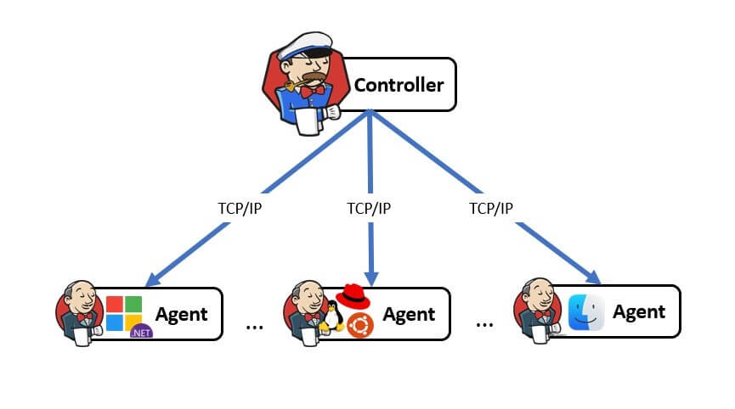
Long Running Controller
The controller
  Maintains persistent state on disk
  Accumulates configuration over time
Retains
  Job definitions
  Build history
  Security credentials
  Plugin data
  User configuration
Different design architecture than
  Stateless web services
  Ephemeral CI runners
  Serverless architectures
Image Credit: https://naiwaen.debuggingsoft.com/2022/06/jenkins-controller-and-agents-architecture/

Slide 21
Long Running Controller
Jenkins controllers
  Retain long build histories
  Preserve logs for auditing
  Track trends over time
  Examples
    Test flakiness trends
    Build duration changes
    Deployment frequency
This historical continuity only works if
  The controller persists
  The file system remains stable

Slide 22
Jenkins Architecture
Jenkins controller
  Central brain of Jenkins
  Responsibilities
    Web UI
    REST API
    Job and pipeline definitions
    Build scheduling and queue management
    Plugin management
    Credential storage
    User authentication and authorization
    Should not run heavy builds
  Referred to as the master node in older versions of Jenkins
Image Credit: https://naiwaen.debuggingsoft.com/2022/06/jenkins-controller-and-agents-architecture/

Slide 23
Jenkins Architecture
Jenkins controller should NOT
  Run heavy builds
  Compile large projects
  Execute tests
Best practice is the builds are never executed on the controller node
  Builds are done by agents
  Jenkins controller is idle most of the time
  But running builds might disrupt the scheduling processes that are the core of the controller functionality
Image Credit: https://naiwaen.debuggingsoft.com/2022/06/jenkins-controller-and-agents-architecture/

Slide 24
Internal Controller Components
Web application
  Runs as a Java web app
  Embedded Jetty servlet container
  UI + API share the same backend
Job configuration store
  Jobs stored as XML on disk
  Pipelines stored either:
    Inline (legacy)
    From SCM (preferred)
Build queue
  Pending builds waiting for executors
  Queue logic decides
    When a job runs
    On which agent
    With which constraints
Executor management
  Executors represent the capacity of an agent to run concurrent builds
Image Credit: https://naiwaen.debuggingsoft.com/2022/06/jenkins-controller-and-agents-architecture/

Slide 25
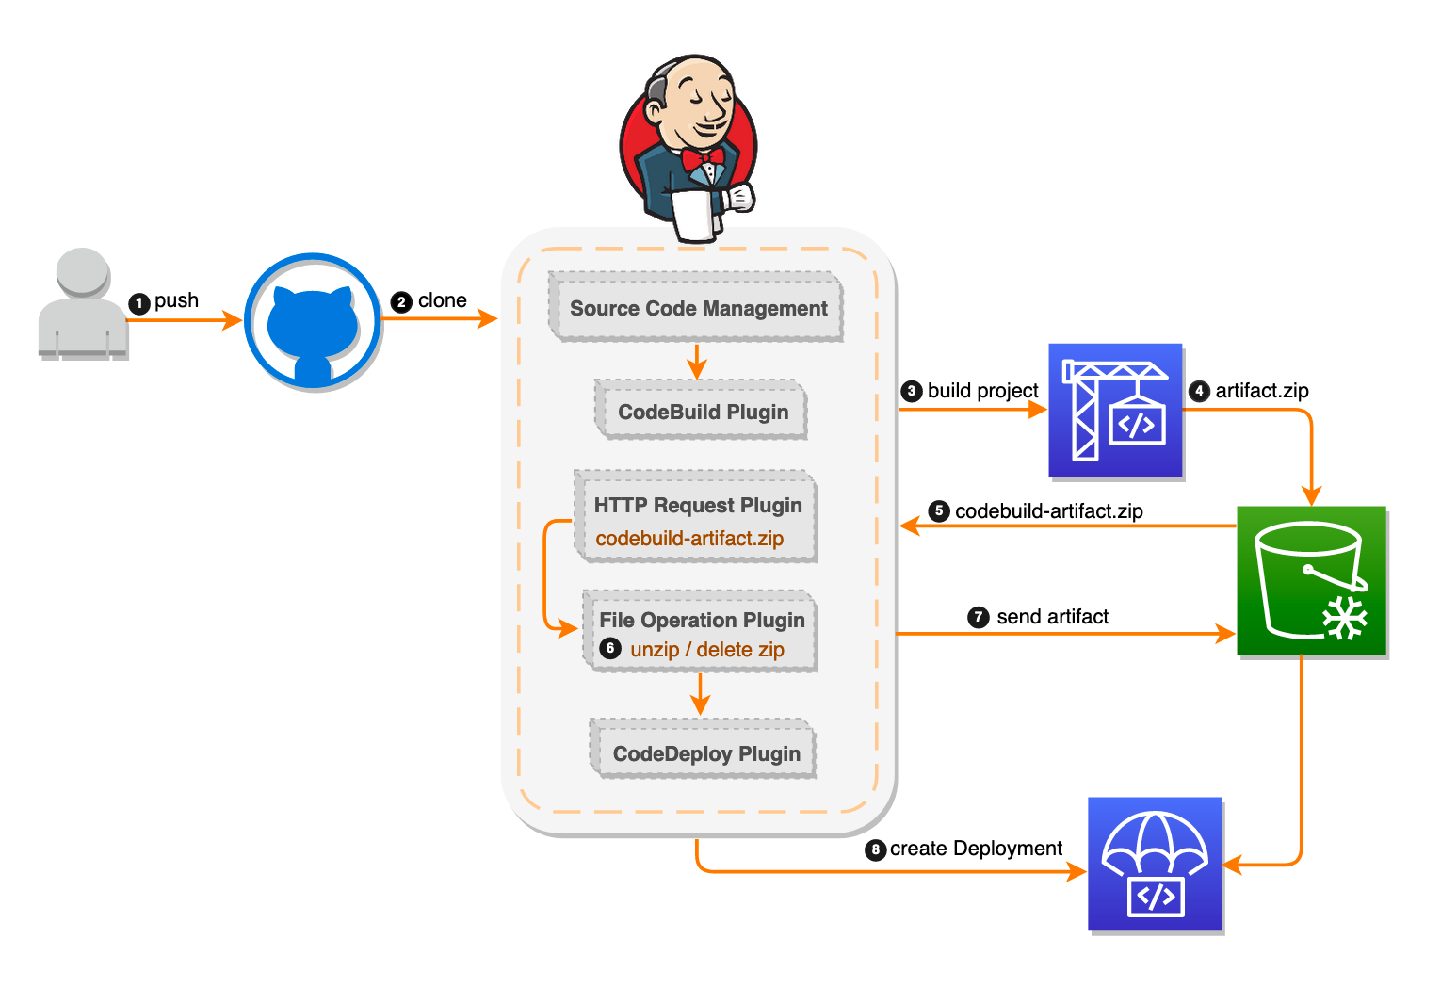
Plugin Ecosystem
Jenkins controller core is intentionally small
  Most functionality comes from plugins
  Thousands of plugins are available
  Examples
    Git / GitHub / GitLab integration
    Pipeline features
    Kubernetes agents
    Credentials and RBAC
  Plugin Risks
    Plugins run with high privileges
    Outdated plugins = security risk
    Version compatibility matters
Image Credit: https://thinkwithwp.com/blogs/devops/setting-up-a-ci-cd-pipeline-by-integrating-jenkins-with-aws-codebuild-and-aws-codedeploy/

Slide 26
Security Model
Authentication: local users, LDAP, SSO
Authorization: role-based access control (RBAC)
  Credentials stored centrally and injected securely
  Fine-grained permissions per job, folder, or pipeline
Governance considerations
  Who can install plugins?
  Who can modify pipelines?
  How are credentials managed?
  How are updates tested and rolled out?
Image Credit: https://thinkwithwp.com/blogs/devops/setting-up-a-ci-cd-pipeline-by-integrating-jenkins-with-aws-codebuild-and-aws-codedeploy/

Slide 27
Controller/Agent Architecture
Using agents provides
  Separation of concerns
    For example, doing builds in different OS environments
  Scalability – can add more agents to manage workloads
  Security isolation – each agent can have its own security profile
Static agents
  Always running
  Simple but resource-heavy
  Common in older Jenkins setups
  Usually a physical host or a virtual machine
Image Credit: https://naiwaen.debuggingsoft.com/2022/06/jenkins-controller-and-agents-architecture/

Slide 28
Controller/Agent Architecture
Ephemeral agents
  Created on demand and destroyed after job completion
  Often container-based or Kubernetes-based
  Better isolation and scalability than static agents
  Considered to be a modern best practice
Execution flow of ephemeral agents
  SCM event triggers pipeline
  Controller schedules work to be done
  Agent spins up
  Pipeline stages execute the work
  Agent is destroyed
Image Credit: https://naiwaen.debuggingsoft.com/2022/06/jenkins-controller-and-agents-architecture/

Slide 29
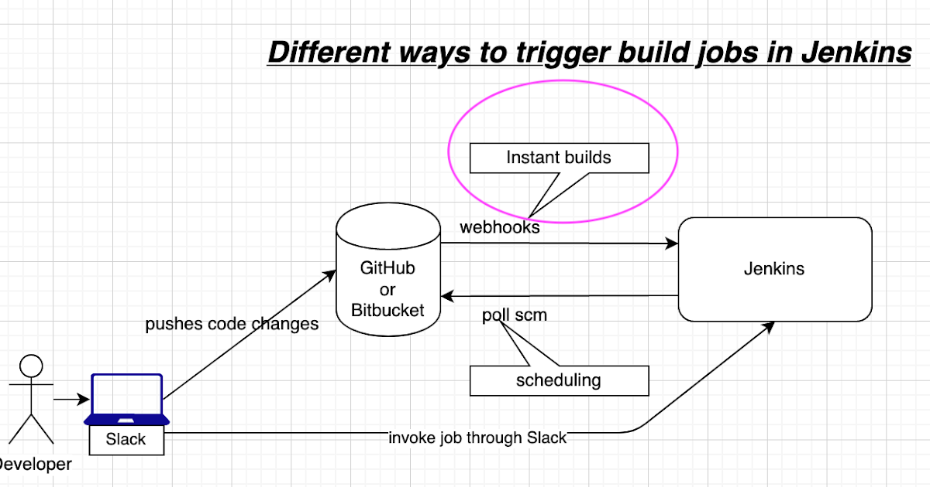
SCM-Driven Automation
Source control as the single source of truth
  For both the application code and pipeline code (Jenkinsfile)
  Pipelines ingest application code
  Jenkinsfile is an IaC specification that defines the CI/CD steps and flow of execution
  Jenkinsfile is versioned with the application
    Similar to how unit and integration tests are versioned
  Changes to Jenkinsfile code
    Follow code review processes
    Subject to the same QA testing as application code
Image Credit: https://www.coachdevops.com/2020/06/how-to-configure-webhooks-in-bitbucket.html

Slide 30
SCM-Driven Automation
Webhooks
  GitHub/GitLab notify Jenkins on:
    Push
    Pull/Merge Request
    Tag creation
  Enables event-driven automation
Image Credit: https://www.coachdevops.com/2020/06/how-to-configure-webhooks-in-bitbucket.html

Slide 31
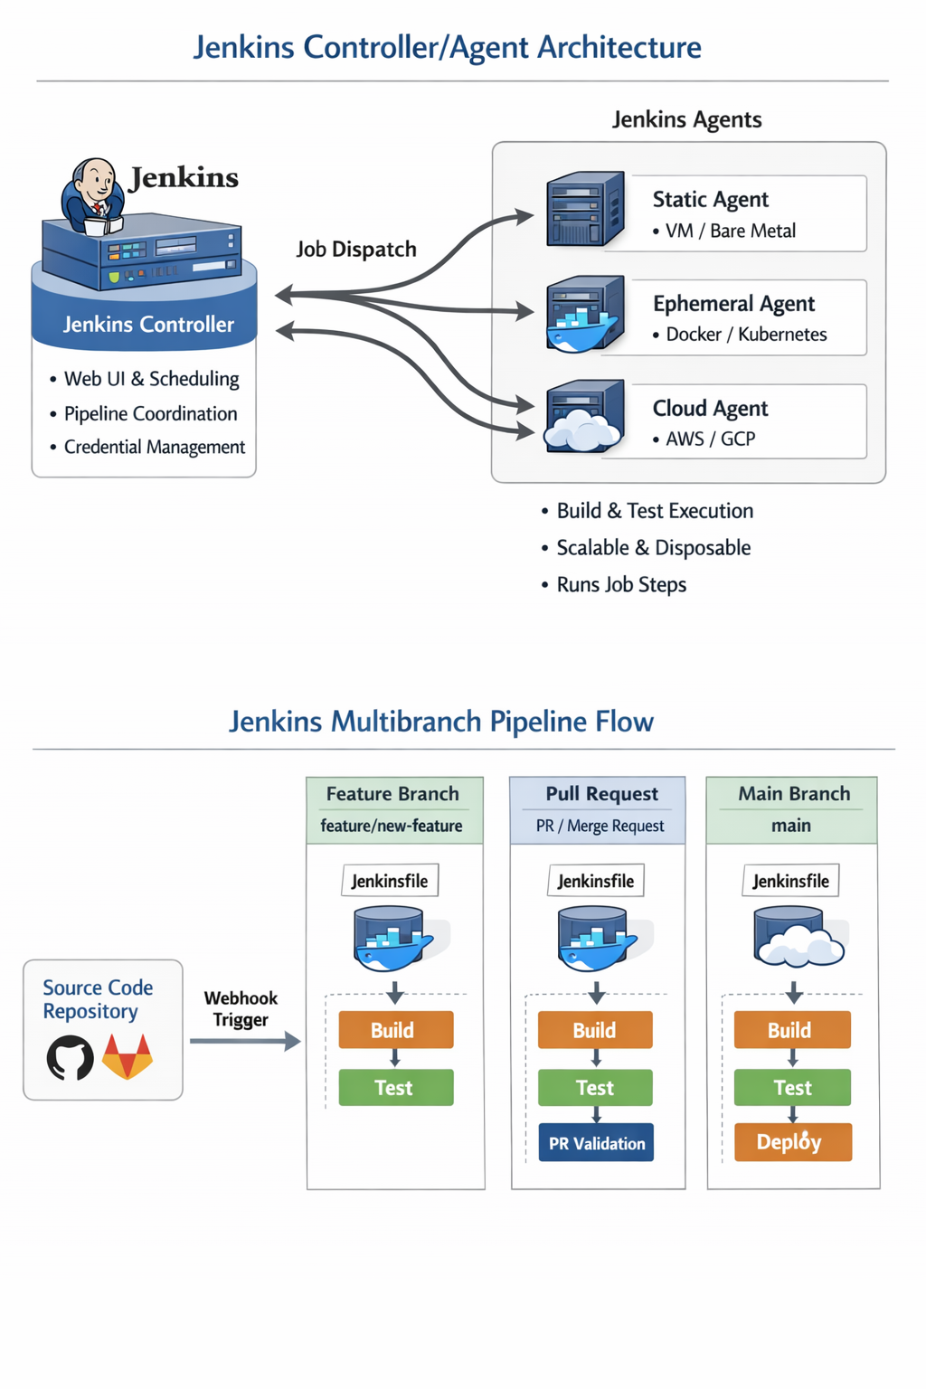
SCM-Driven Automation
Multibranch Pipelines
  Jenkins automatically discovers branches
  Each branch can have its own Jenkinsfile
Enables
  Pull request validation
  Feature branch testing
  Main branch deployments

Slide 32
Installing Jenkins LTS
Installing Jenkins means:
  Installing the Jenkins controller
  Running it as a long-lived service
  Preparing it to manage jobs, pipelines, and agents
Jenkins is a Java application distributed as
  Native packages (RPM, DEB) or Windows MSI
  WAR file
  Docker image
Always start with LTS unless there is a reason for using the weekly build

Slide 33
Installing Jenkins LTS
Native Package Install
  Installed as a system service
  Runs on a VM or server
  Direct access to filesystem
  Traditional enterprise model
WAR File
  Portable
  Manual startup
  Often used for testing or learning
Docker
  Containerized Jenkins controller

Slide 34
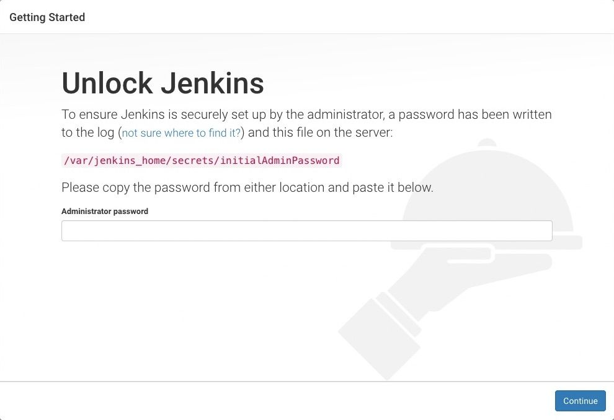
Installing Jenkins LTS
During the first startup
  Jenkins creates $JENKINS_HOME
  Default configuration files are generated
  Initial admin password is created
  Setup wizard is triggered

Slide 35
Initial Setup Wizard
On first startup, Jenkins
  Locks itself
  Requests an admin password
  Prompts for plugin installation
  Creates the first admin user
  Sets basic configuration

Slide 36
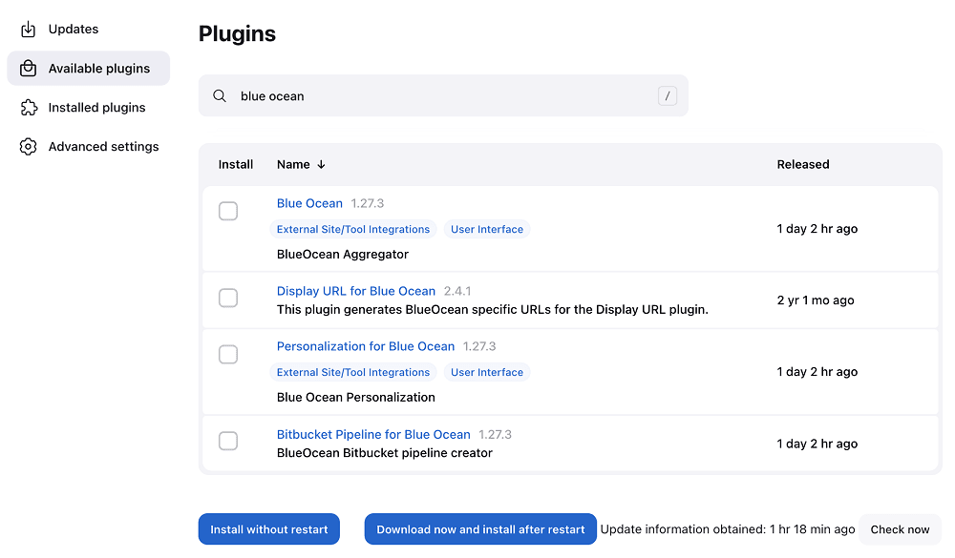
Plugin Selection
Two common choices:
  Suggested plugins
  Custom plugin selection
For most installations
  Suggested plugins are sufficient
  Plugins can always be added later
  However, removing them is harder

Slide 37
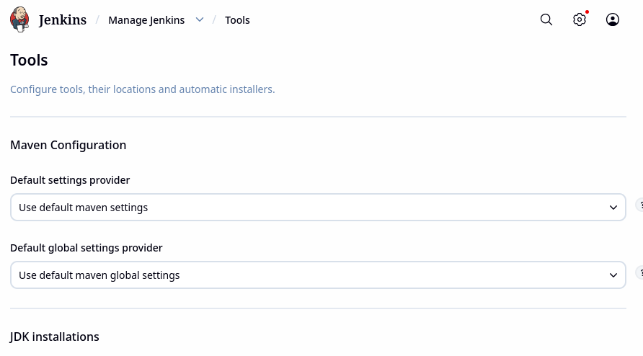
Global Tools Configuration
Global tools:
  Are not binaries
  Are not installed on the controller
  Are not automatically present on agents
  Are named tool definitions
  Are stored in Jenkins configuration
Used by pipelines as references
  Global tools are labels, not software

Slide 38
Reference Tools by Name
In a Jenkinsfile:
  “Use Maven version maven-3.9”
  The name “maven-3.9” is defined globally in Jenkins
  Abstracts away
    Version numbers
    Installation paths
    Agent OS differences
Benefits
  Pipelines become portable
  Jenkins controls versions centrally
  Developers don’t hardcode paths to build tools in pipeline code

Slide 39
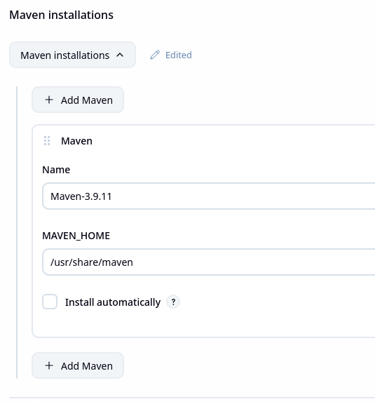
What Happens at Runtime
Step 1: Pipeline starts
  Controller reads the Jenkinsfile
  Sees: “This pipeline needs Maven maven-3.9”
Step 2: Agent is selected
  Controller assigns an agent
  Agent may be:
    A VM
    A Docker container
    A Kubernetes pod
Step 3: Tool resolution
  Controller sends the tool definition to the agent
  Definition includes:
    Tool type (Maven, JDK, Node)
    Version
    Installation strategy

Slide 40
What Happens at Runtime
Step 4: Tool installation (if needed)
  On the agent, if tool is already installed then it is used
  If not
    Jenkins downloads it
    Installs it locally
    Caches it for reuse (if agent persists)
Step 5: Tool execution
  Agent updates PATH and environment variables
  Pipeline steps run
  Controller receives logs and results

Slide 41
What Auto-Install Means
Jenkins can download tools automatically
Controlled by:
  Tool definition settings
  Plugin support
  Agent permissions
Benefits
  No manual agent setup
  New agents work immediately
  Ephemeral agents become practical
Pitfalls
  Builds depend on external downloads
  Tool versions can change unexpectedly
  Network failures can break builds

Slide 42
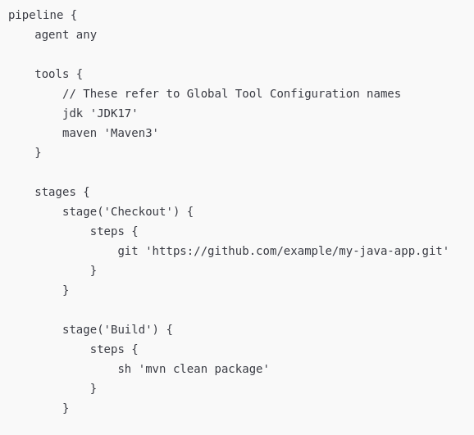
Ensuring Consistent Builds
Without global tools
  Each agent might have different versions
  Pipelines hardcode paths
  “Works on my agent” problems appear
With global tools
  Jenkins enforces version consistency
  Pipelines are environment-agnostic
  Upgrades are centralized and controlled
Critical when
  Multiple teams share Jenkins
  Agents are ephemeral
  Jenkins uses containers or Kubernetes

Slide 43
Controller vs Agent Tooling
Controller responsibilities
  Stores tool definitions
  Defines names and versions
  Decides what tools are needed
  Never runs builds
Agent responsibilities
  Installs tools
  Executes commands
  Runs builds and tests
  Cleans up afterward
The controller is the planner
The agent is the worker

Slide 44

Running Jenkins in Docker
Docker helps solve common Jenkins problems
  Consistent environments
  Easier upgrades
  Simplified rollback
  Faster setup for labs and training
Jenkins in Docker is NOT Jenkins as a stateless service
  The controller still needs persistent storage

Slide 45
Running Jenkins in Docker
Persistent volumes
  Jenkins state must survive container restarts
  $JENKINS_HOME is mounted to a volume
  Losing this volume = losing Jenkins
Container Lifecycle
  Container can be destroyed and recreated
  Jenkins data remains intact
  Encourages clean operational practices

Slide 46
Running Jenkins in Docker
Running Jenkins in Docker means
  Jenkins runs inside a container
  Jenkins data lives in a mounted volume
  The container can be replaced without losing Jenkins state
  Provides control, consistency, and safety without changing Jenkins’ architecture

Slide 47
Docker: Fast and Predictable Setup
Without Docker
  Install Java
  Configure OS packages
  Manage service startup
  Troubleshoot environment differences
With Docker
  Pull the Jenkins LTS image
  Start a container
  Jenkins is immediately usable
  Everyone gets the same Jenkins
  Avoids setup chaos

Slide 48
Docker: Environment Consistency
Docker ensures
  Same Jenkins version
  Same Java version
  Same default configuration
  Same filesystem layout
Eliminates
  “Works on my machine”
  OS-specific surprises
  Hidden dependencies

Slide 49
Docker: Modern Jenkins Practices
Jenkins has evolved to support
  Configuration-as-Code (JCasC)
  Ephemeral agents
  Cloud deployments
  Kubernetes deployments

Slide 50
Docker: Reduced Operational Risk
Avoids common Jenkins failures
  Broken Java upgrades
  OS package conflicts
  Accidental system changes
  Hard-to-reproduce environments
Important because
  Jenkins controllers are long-running
  Downtime is disruptive
  Recovery needs to be predictable

Slide 51
When to Avoid Docker
Very high-scale enterprise setups
Strict compliance environments
Existing Jenkins infrastructure already standardized

Slide 52
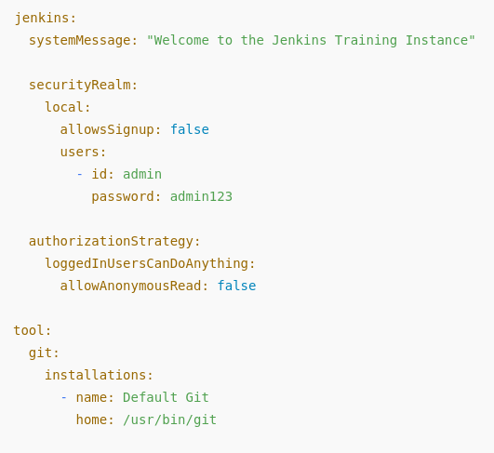
Configuration-as-Code (JCasC)
Configuration-as-Code (JCasC) is where
  Jenkins configurations are defined in YAML files
  Loads the configuration automatically at startup
  Treats Jenkins configuration like application code
Declarative
  Describes how Jenkins should be configured
  Replaces configuring Jenkins through the UI

Slide 53
Configuration-as-Code (JCasC)
JcasC, can define
  Security settings
  Authentication and authorization
  Users and roles
  Credentials
  Global tools (JDK, Maven, Node, etc.)
  Plugin configuration
  System settings
But not
  Individual pipeline logic
  Build steps inside Jenkinsfiles
  Pipelines are code, JCasC is configuration.

Slide 54
Configuration-as-Code (JCasC)
JCasC YAML files are stored on disk
Often mounted into Jenkins via:
  Docker volumes
  ConfigMaps (Kubernetes)
JCasC is applied at
  Jenkins startup
  Configuration reload (optional)
What Jenkins does
  Jenkins starts
  JCasC plugin reads YAML
  Jenkins configures itself accordingly
  UI reflects the defined state

Slide 55
Benefits
Makes Jenkins reproducible
Supports automation and version control
Enables safer upgrades
Helps avoid snowflake Jenkins which
  Were configured manually over time
  Have unique, undocumented settings
  Cannot be easily recreated
  No one fully understands anymore
  Breaks when you try to upgrade or migrate
Called a snowflake because it’s unique and melts under pressure

Slide 56
Snowflake Instances
Common causes
  Clicking through the UI to configure Jenkins
  Installing plugins “just to try something”
  Making emergency fixes directly on the server
  Manually editing config files
  Installing tools directly on agents
  No version control for configuration
Over time
  The original admins leave
  Configuration knowledge is lost

Slide 57
Questions

